Slide 1

Resiliency
for
Better Performing Teams

Slide 2
Personal Leadership Coaching
Corporate Training
Performing Under Pressure
The Three Conversations of Leadership
WORK LIFE SPORT SCHOOL
Jo-Ann Pawliw

Slide 3



Slide 4
So…
What’s getting in the way?

Slide 5
Change Webinar Pre Survey
91% of people agreed or strongly agreed that they are feeling pressure from the amount of change they face
Only 5% of people strongly agreed they feel equipped to handle the pressure

Slide 6
IHHP’S RESEARCH
In our study of 12,000 people,
the bottom 90% performers had a haphazard approach
for dealing with the pressure of change.
The top 10% had a plan and strategies to
perform under pressure

Slide 7
Objectives:
Managing the “O’s”
Ourselves
Others
Our Communication

Slide 8
Managing the “O’s”
Ourselves
Others
Our Communication

Slide 9
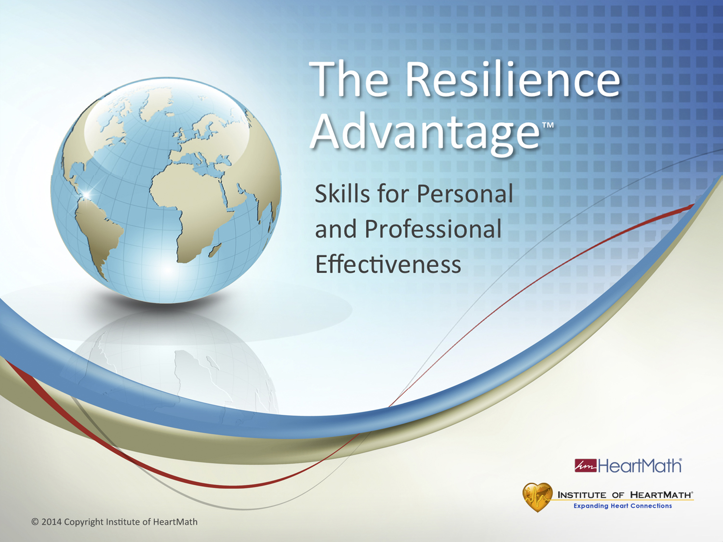
Notes:
Time: 3 minutes
Objective: Introduce yourself, welcome everyone to the training and build rapport with participants.
Key Points:
(Welcome and build rapport with participants.)
(Introduce yourself. Tell an appropriate story relating to the benefits you’ve gained using the HeartMath tools.)
(Discuss logistics: breaks, restroom locations, guidebooks, etc.)
(Announce modules or give overview of topics you plan to cover.)
Optional opening comments:
Today you will learn simple, resilience-building techniques you can use throughout the day.
Resilience gives you the benefits of better sleep, improved teamwork and morale, the ability to deal with difficult clients and increased ability to focus, process information, solve problems and enhance creativity.
As with most things that are worthwhile, it does take effort to build your resilience. The skills you will learn today are very practical and can be used on the go, no matter what you are doing or where you are.
(Discuss break times, how the workshop will unfold, such as in individual and small group exercises, time for personal reflection, program evaluation if you plan to ask them to do one and other relevant logistics.)
Transition: There is a wide range of organizations using the same resilience skills you will learn today.

Slide 10
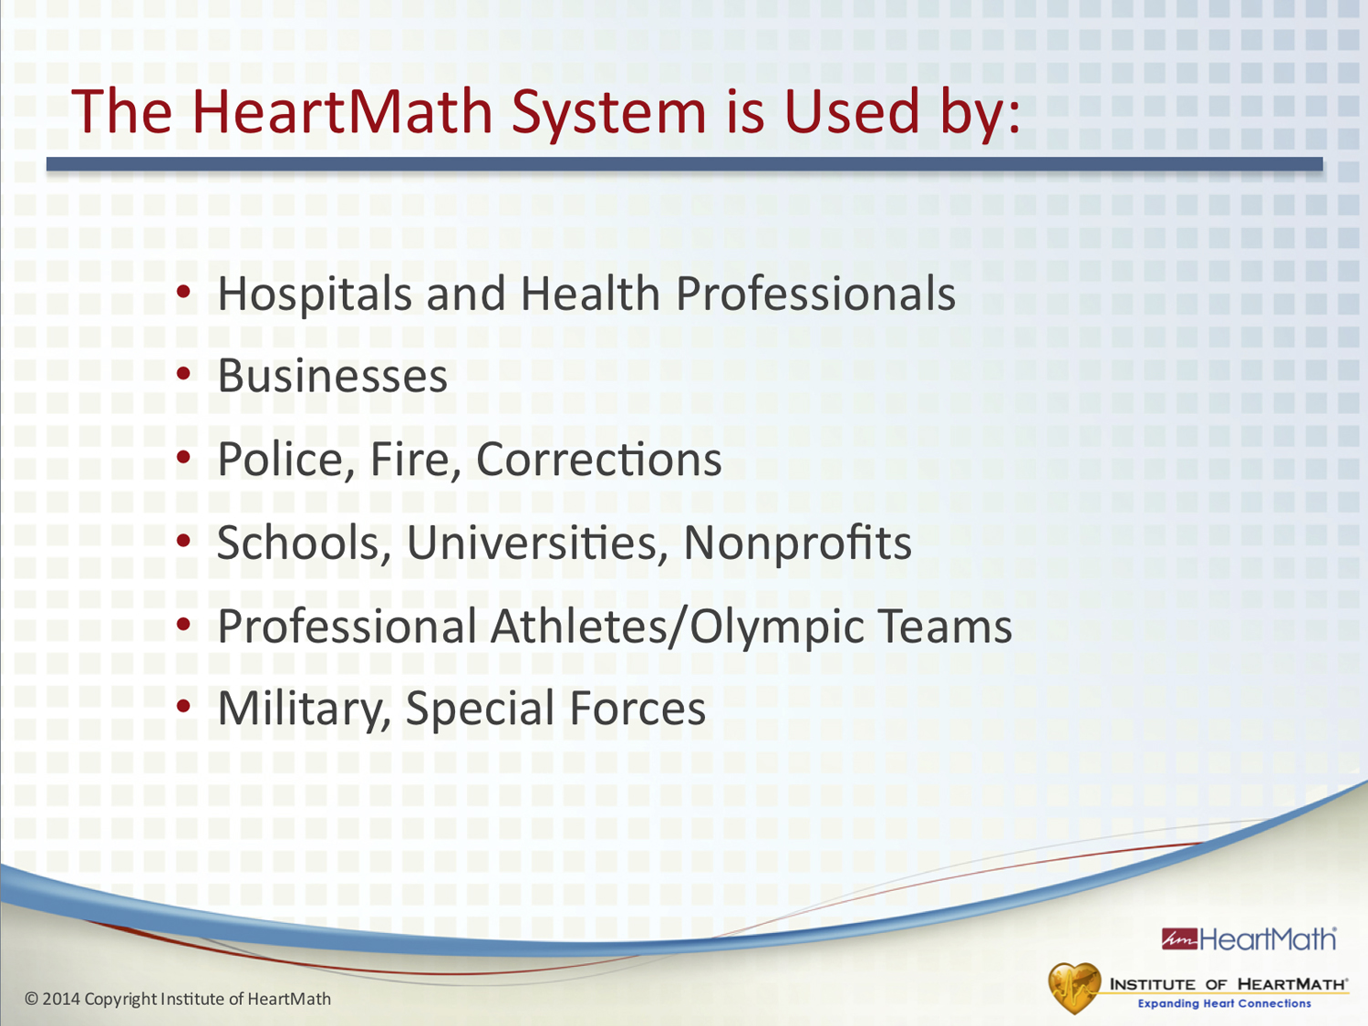
Notes:
Time: 1 minute
Objective: Build program credibility.
Key Points:
Many people around the world and in a variety of organizations use the HeartMath System.
The resilience-building skills are taught in various training programs tailored to specific types of audiences.
Additional Key Points:
• The HeartMath System is used by: Businesses, nonprofits, hospitals and health professionals that want to improve the culture of their workplace environments and reduce escalating health-care costs.
• Police, fire and corrections organizations that want to improve their personnel’s ability to respond effectively and appropriately without the depleting effects of prolonged stress.
• Schools, universities and youth agencies that want to improve student behavior and academic performance while lowering stress.
• Olympic teams and elite athletes who want to gain an advantage in their performances.
Military personnel seeking to build stress resilience and reduce post-traumatic stress disorder.
Transition: Research across a wide range of topics and applications validates the HeartMath System.

Slide 11
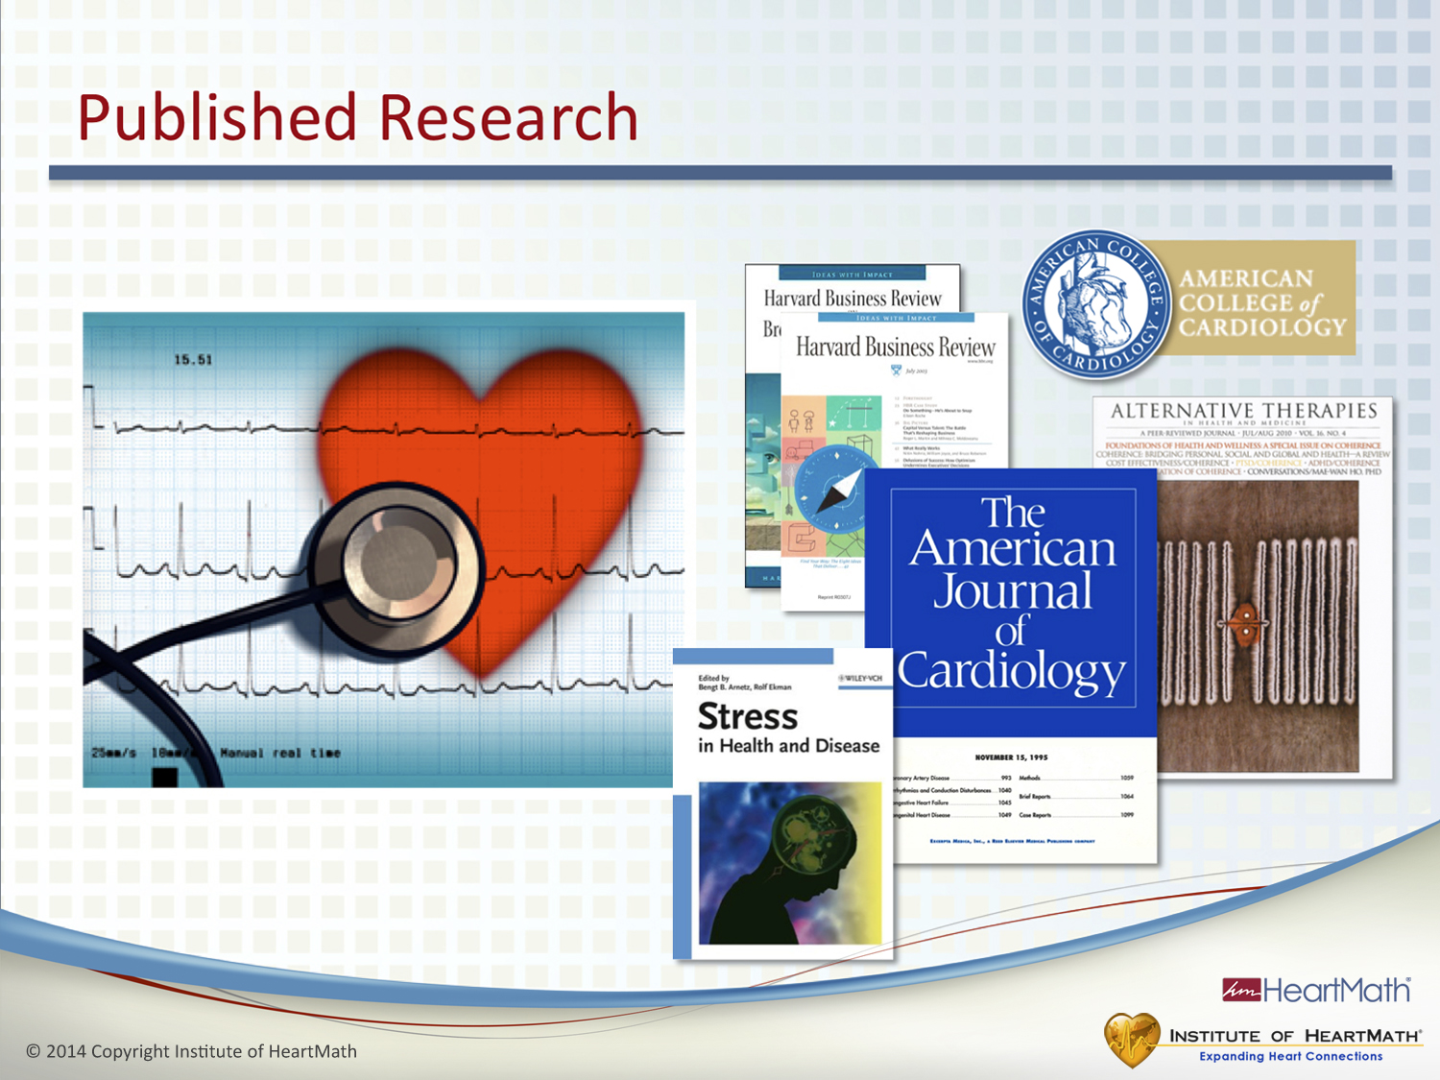
Notes:
Time: 1 minute
Objective: Build further program credibility.
Key Points:
•The HeartMath System is an evidence-based methodology. The HeartMath Research Center, independent researchers and universities have published numerous studies that validate the HeartMath System.
•These studies have been published in numerous peer-reviewed journals.
Resilience Advantage Slide Notes © Copyright 2014 Institute of HeartMath
Additional Key Point:
•Among many other journals, HeartMath’s research has been published in the American Journal of Cardiology, Global Advances in Health and Medicine, Stress Medicine and the Journal of the American College of Cardiology. All material presented in this program is backed by research. A bibliography referencing the material presented in the workshop is located in the back of the guidebook.
Transition: Let’s look at the objectives for today’s program.

Slide 12
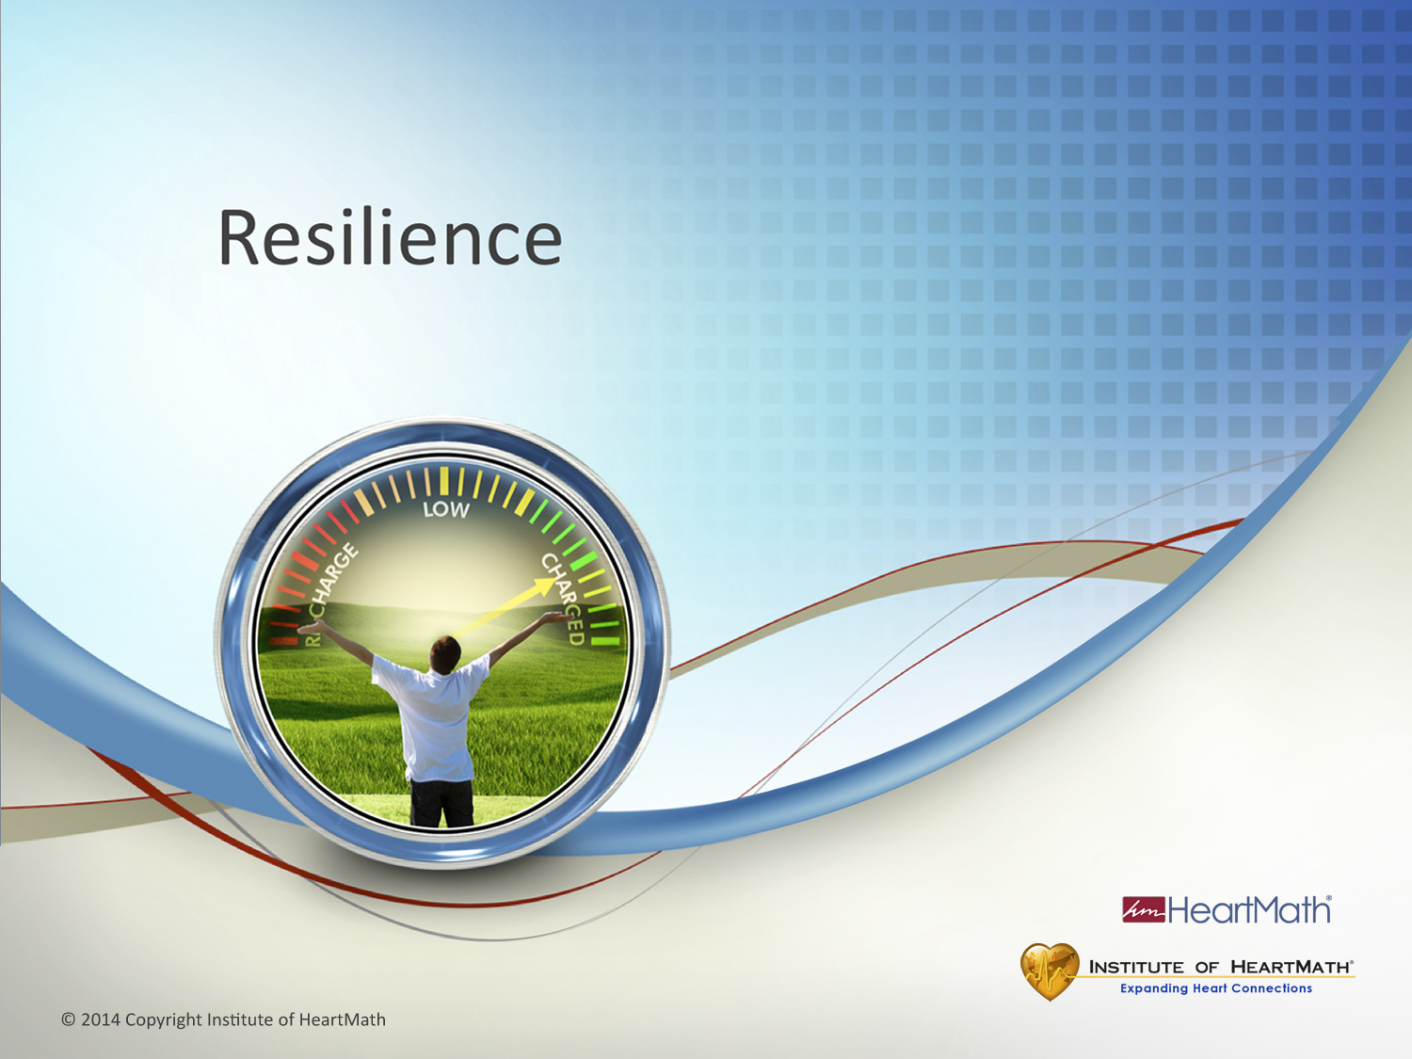
Notes:
Resilience Introduction
Time: 1 minute
Objective: Engage the audience in talking about what resilience means to them.
Key Points:
Ask: What does “resilience” mean to you?
Additional Key Points:
(Optional) Ask: When you are resilient, what do you notice about yourself?
Resilience is commonly thought of as the ability to bounce back after a challenging situation. It’s important to be able to bounce back, but there is much more to resilience than bouncing back.
Transition: Let’s look more closely at resilience, why it’s important and its practical benefits.

Slide 13
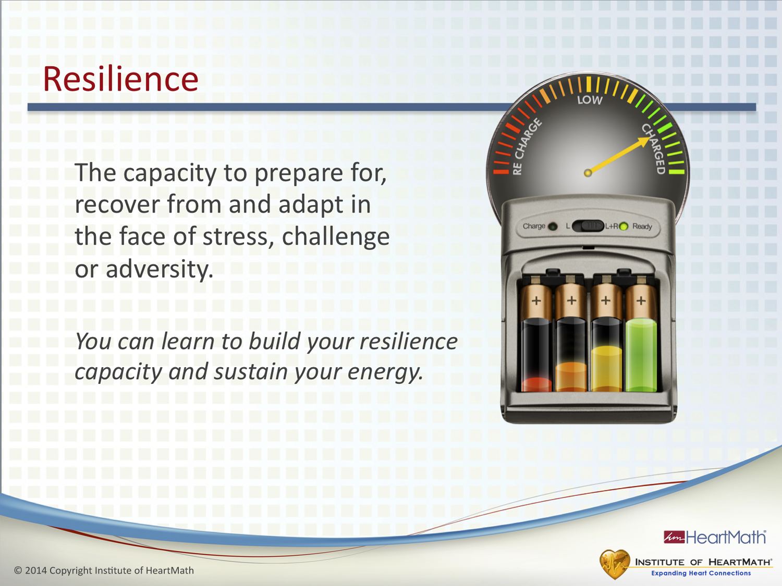
Notes:
Time: 3-5 minutes
Objective: Introduce participants to the concept of resilience, why it’s important and its benefits.
Key Points:
•Our understanding of resilience has been evolving. The HeartMath definition of resilience captures a newer and broader understanding of resilience. (See slide.) Resilience is the capacity to prepare for, recover from and adapt in the face of stress, challenge or adversity.
•Capacity is a key term that is fundamental to understanding resilience. Capacity is how much of something you can have.
•You can increase your capacity and accumulate or store resilience.
•Greater capacity means you have more to draw from when you need it.
•You can think of your resilience as the amount of energy you have stored in an inner battery. It’s the amount of energy you have available.
•Ask/Say: Think of an event or situation that irritates or frustrates you. When your energy level is low, how do you respond in that situation? Are you more easily frustrated? Does it get under your skin more easily? When your inner battery is charged, how do you respond? Are you more flexible and do you roll with the punches? Can you think more clearly? (Pause.) The situation is the same. The difference in the way you respond to things often depends on the amount of energy you have available.
•Resilience capacity varies from day to day.
•Having more resilience/energy in your inner battery helps you to be better prepared for and often avoid many of the situations and challenges from which you need to bounce back or recover.
•The greater your capacity and resilience, the greater your ability to maintain your composure and stay in charge of your reactions and perceive things more clearly.
•Building and sustaining resilience means becoming more intelligent about how you use your energy and replenish your energy reserves.
•Greater resilience helps to prevent stress buildup.
•In other words, the more intelligently you manage your energy expenditures and recharge your inner battery, the more energy you have and the more resilient you are. You then have greater ability to self-regulate and be in charge of your emotions in the moment.
Transition: Let’s expand the resilience concept further.

Slide 14
One Word
What word describes you when you are at your best at work?
What does it feel like when you are at your best?

Slide 15
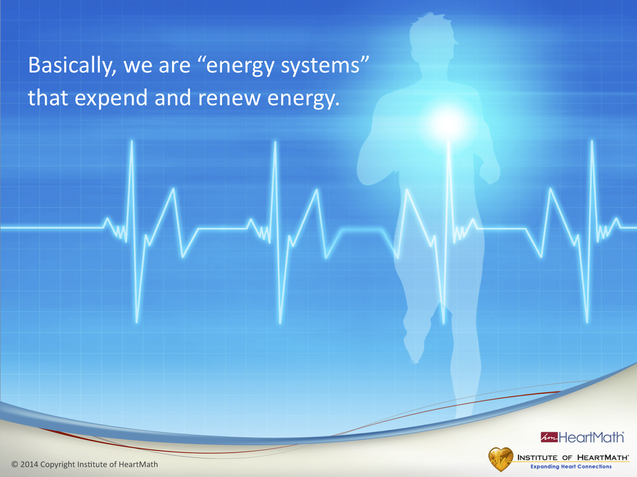
Notes:
Time: 30 seconds
Objective: Inform participants that we are energy systems.
Key Points:
•Every day we wake up with a certain amount of energy to spend. Basically we are energy systems that expend and renew energy. In order to remain healthy and resilient, we have to manage how we spend our energy.
•Even at the most basic physiological level, our metabolism converts the food we eat into usable energy, so we are constantly expending and renewing energy.
Transition: We have different types of energy across several interrelated domains.

Slide 16
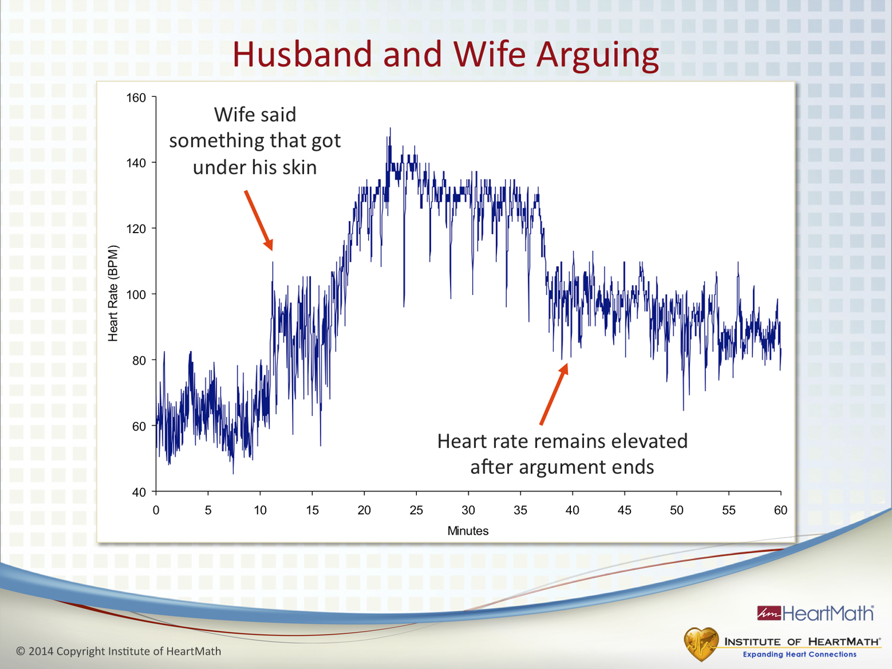
Notes:
Time: 2 minutes
Objective: Illustrate the idea that emotions are primary drivers of our physiology.
Key Points:
A man was wearing a 24-hour Holter monitor, which is used to measure heart rhythms.
He and his wife were arguing in their car. The man was sitting on the passenger side wearing his seatbelt. When they began arguing, his heart rate shot up to over 140 BPM and remained elevated at that rate for about 15 minutes.
After they made up, his heart rate remained elevated for another hour. (Point to second red arrow.)
Ask: How much energy did he burn up from being angry or frustrated?
The result was a rapid drain of his inner battery. This is a good way of illustrating that emotions are primary drivers of physiology.
Ask: How much emotional energy is unnecessarily spent in the workplace because of drama, relationship and communication issues?
Transition: Our emotions directly affect our resilience.

Slide 17
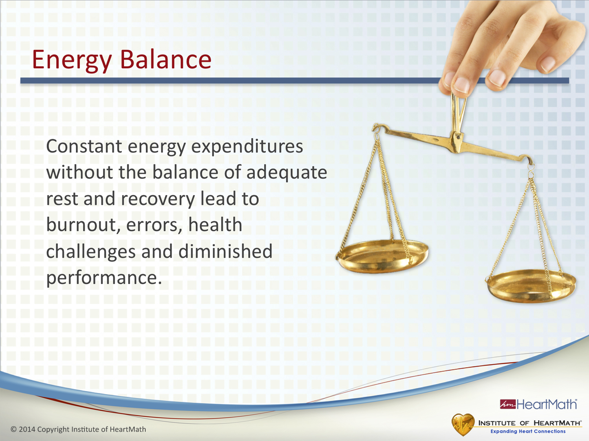
Notes:
Time: 1-2 minutes
Objective: Explain the concept: We tend to expend more energy than we renew.
Key Points:
People tend to expend more energy than they recover.
It’s the constant energy expenditure without adequate renewal that leads to diminished resilience.
Ask: What do you notice when your personal energy is low? Do you tend to make more mistakes? Do little things tend to get under your skin more easily?
Sleep is one of the primary ways we renew energy.
Additional Key Points:
One way to understand energy expenditures and renewal is to consider what happens to your cell phone when you use it a lot during the day and don’t recharge it at night. The battery drains. It works the same way when you don’t keep your inner battery charged. The energy in your inner battery drains and your resilience drops. Eventually, decreased resilience leads to burnout, mistakes, reduced performance and diminished health.
Carryover effects from stressful feelings such as frustration or annoyance deplete your system and are major factors in disrupting the quality of your sleep and your ability to renew and recharge your inner battery. When you don’t get enough sleep or you sleep poorly, your inner battery can’t fully recharge. That means starting the next day with less resilience.
Transition: Next, let’s look at how depletion can affect our health, behavior and performance over time.

Slide 18
Stress, Resilience and Performance
Embraces challenge and improves performance
Period of
maximum efficiency
Hyper-reactive
stage
Emotional exhaustion
stage
Breakdown
Time (Days)
Notes:
Time: 3 minutes
Objective: Explain the concept that sustained energy output associated with challenges or stress affects our health, behavior and performance.
Resilience Advantage Slide Notes © Copyright 2014 Institute of HeartMath
Key Points:
•Ask: Are you familiar with the idea that stress can improve performance? People often talk about “good stress” and how they need stress to get the job done. That can be true, but only to a point.
•A better term than stress in this context is challenge.
•What people often mean is they need a challenge to motivate them to get the job done.
•(CLICK to add the next text block.)
•When faced with a challenge such as a project, sporting event or relationship issue, we can increase performance by embracing the challenge and having a positive attitude about it, meaning that it’s something we enjoy doing.
•(CLICK to add the next text block.)
•(Point to the top of the red line under “Period of Maximum Efficiency.”) The increase in performance is followed by a period of maximum efficiency.
•Ask: If a challenge is not embraced with a positive attitude, what do you think happens to performance?
•(Point to the red line.) If the level of stress or challenge remains high without adequate tools for maintaining resilience, your energy could become drained and your performance could begin declining. Basically, the charge in your inner battery begins dropping. (CLICK to add the next text block.) This is called the hyper-reactive stage. This is the point at which we are more reactive and anxious. People experience more memory problems in this stage and mistakes start occurring. This is when the small stuff starts to get to us. It’s also when it becomes more difficult to self-manage reactions, emotions and attitudes, all of which can trigger a downward spiral and further energy drain.
•(CLICK to add the next text block.)
•The next stage is called the emotional exhaustion stage. This is when your inner battery becomes even more depleted, resulting in more serious problems.
•(CLICK to add the next text block.)
•The goal is to reach the blue line, where you can sustain your resilience and performance over time.
•Using the techniques in this program and being more intelligent about how you expend and renew energy can help you build and sustain resilience.
•Ask: Can you relate to any of this?
Transition: Ask: Anyone up for watching a movie?

Slide 19
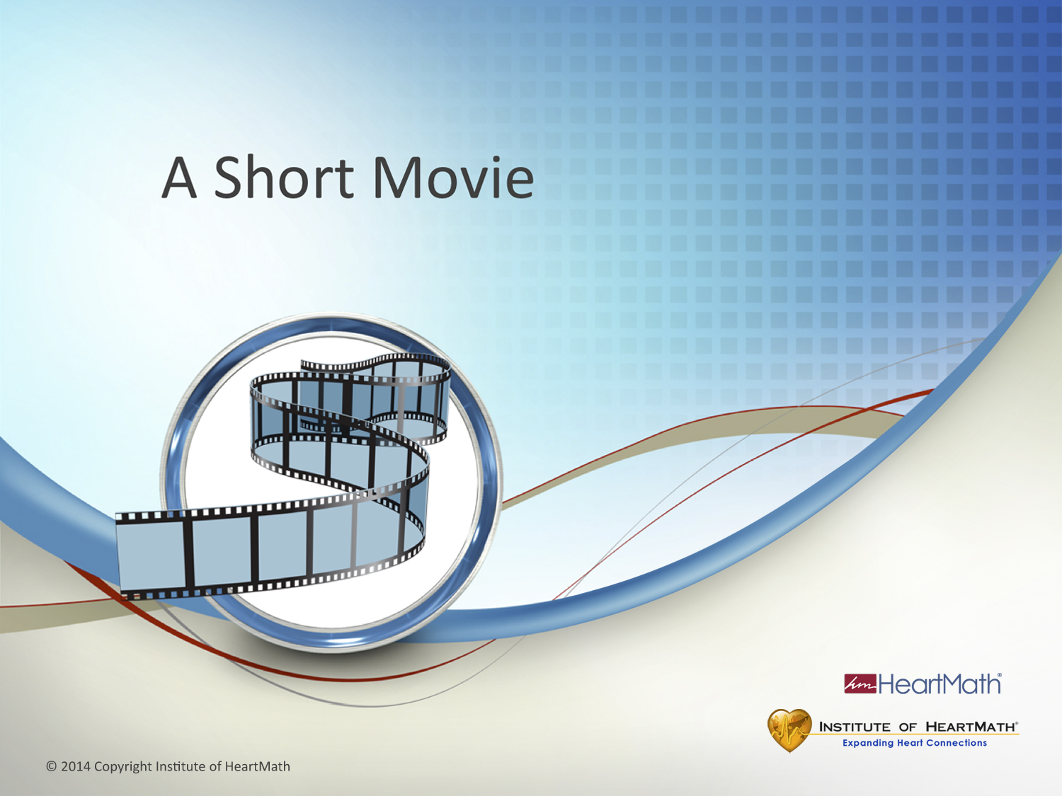
Notes:
Time: 15 seconds
Objective: Prepare participants to watch the movie.
Key Points:
Notice how you feel as you watch the movie.
(Click to the next slide and play the movie.)
Ask: Does anyone remember the caption at the end of the movie? (Wait for response.) You see the world through how you feel.
Transition: Ask yourself what was your soundtrack when you were watching the movie?

Slide 20


Slide 21
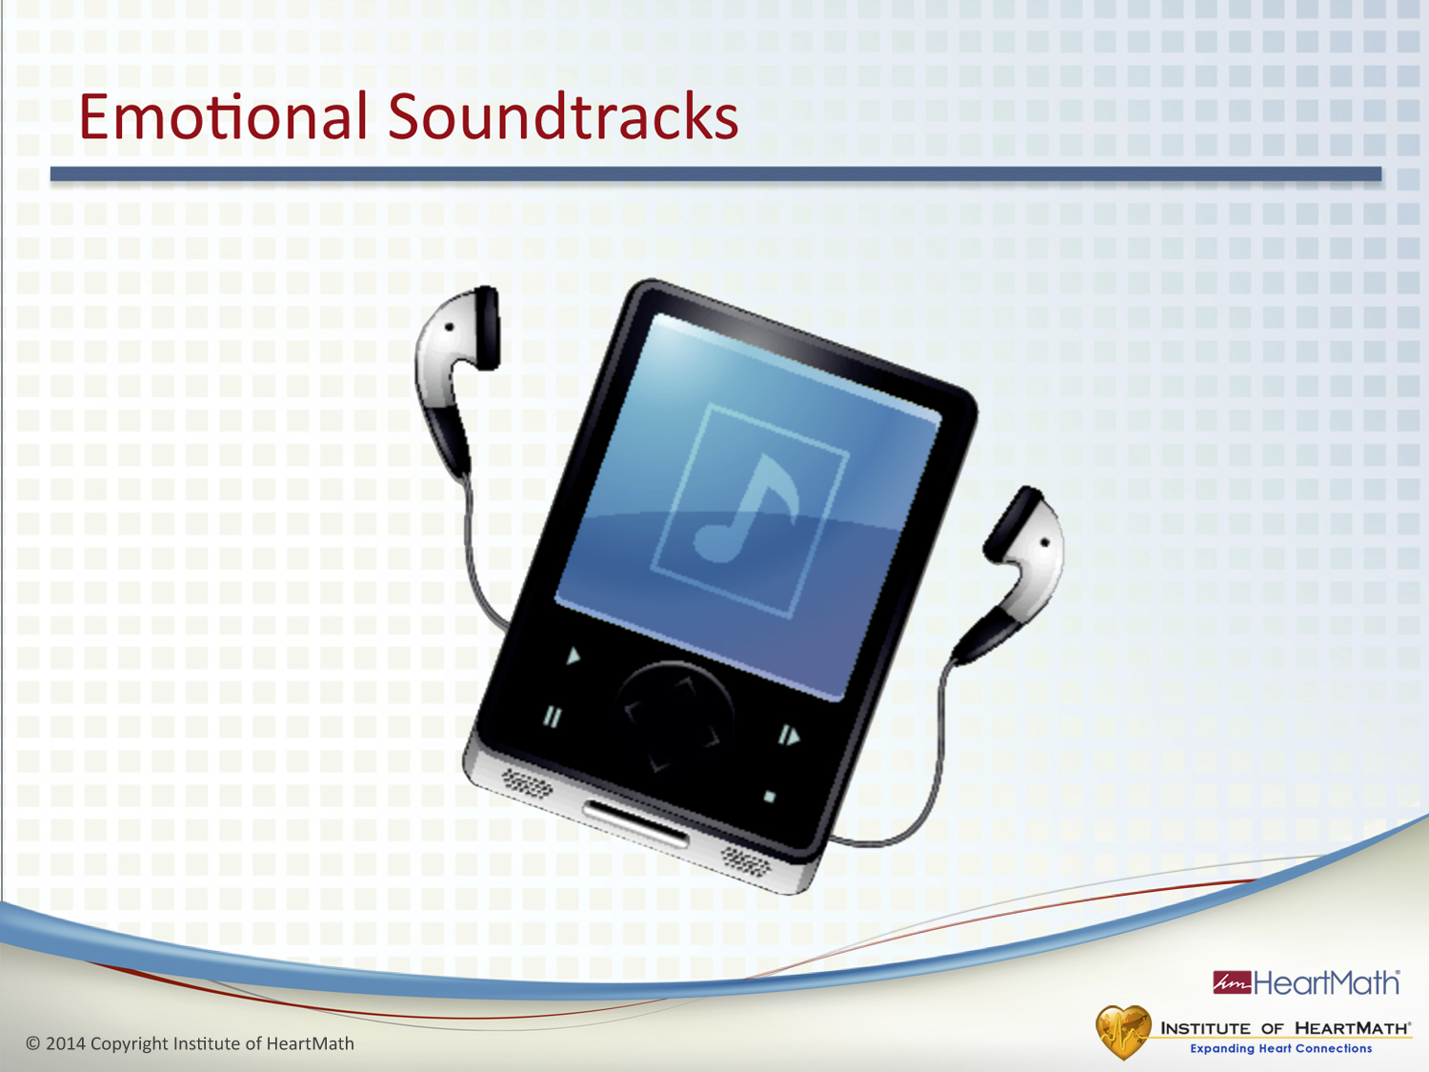
Notes:
Time: 3 minutes
Objective: Introduce the concept that emotions are like background music and influence the quality of our life experience, perceptions, decisions and relationships.
Key Points:
•Ask: What did you experience during the first taxi ride? (Examples of possible responses are chaos, tension, unease and overwhelm.)
•Ask: What did you experience during the second taxi ride? (Examples of possible responses include calm, harmonious, a slower pace and hopeful.)
•Ask: What was the difference between the two movies? Did you notice that the only difference between the two movies was the background soundtrack?
•The perception of what we experienced changed based on how we felt about the music.
•Just like the film’s background music affected how we felt, emotions influence our perception and the quality of our day.
•Emotions run in the background all the time, whether or not we are aware of them. Ask yourself, what are the inner soundtracks you run in the background?
•These two movies illustrate that our emotions influence our perceptions, decisions and relationships – nearly everything that happens in our daily lives.
Transition: Emotions not only affect the quality of our day, but can have other significant effects too.

Slide 22
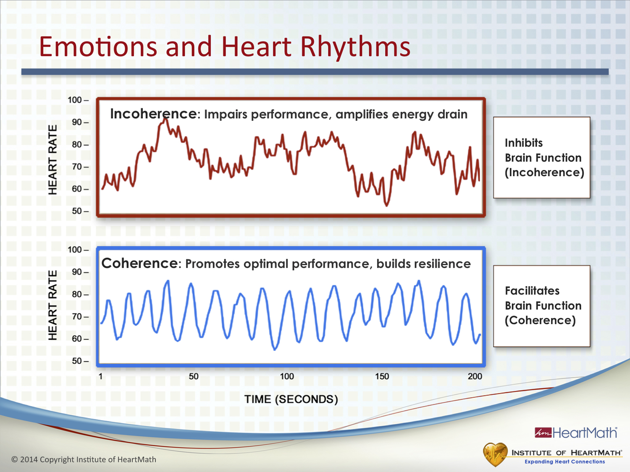
Notes:
Time: 5 minutes Objectives: Explain how emotions are reflected in the patterns of our heart rhythms. Explain that HRV patterns can be coherent or incoherent at low or high heart rates. Explain that a subject’s coherent or incoherent HRV patterns can sometimes have the same amount of variability. Explain that the HRV patterns in heart rhythms indicate whether a subject is in a coherent or incoherent state. Instill confidence in participants that with practice, they can learn to shift from incoherence to coherence, anywhere, anytime.
Key Points:
The two heart rhythms on this slide belong to the same person.
Ask: (Refer to slide.) What do you think the person was doing that created the top heart rhythm pattern? (Pause.) She was instructed to feel frustration. When she shifted to feeling frustrated, her heart rhythms became chaotic-looking.
Depleting emotions such as frustration, impatience or anxiety are reflected in an irregular, chaotic HRV pattern, indicating that the activity between the sympathetic and parasympathetic systems is out of sync.
Scientists call this an incoherent heart rhythm.
This is similar to driving a car with one foot on the accelerator and riding the brake with the other foot. Remember, the sympathetic branch speeds processes up and is like the gas pedal. The parasympathetic branch is like the brake pedal: It slows down processes.
Ask: Why is this not a good idea? Driving in this manner leads to: A jerky ride., Increased wear and tear on the car, Decreased gas mileage and an inefficient use of energy, which is analogous to a rapid energy drain when we’re frustrated, etc.
The heart sends a lot of information to the brain through the ANS. Incoherent heart rhythms inhibit brain function, impairing performance and amplifying energy drains.
Ask: What do you think the person who created the bottom heart rhythm pattern was doing? (Pause.) She was asked to feel appreciation. When she shifted into feeling appreciation, her heart-rhythm pattern changed.
Renewing emotions such as appreciation create a more ordered, harmonious pattern reflecting that the activity between the sympathetic and parasympathetic systems is in sync.
Scientists call this a coherent heart rhythm.
Incoherent rhythms reflect out-of-sync activity in the two branches of the ANS while coherent rhythms reflect synchronized activity.
Coherence helps promote optimal performance and brain function and builds resilience.
A coherent state is not necessarily the same as relaxation. In other words, you can have a high heart rate or a low heart rate and still exhibit an ordered, coherent pattern.
People can be relaxed, which is indicated by a low heart rate, but still be rehashing and processing an argument from earlier in the day. Their systems will be incoherent and they will be draining a lot of energy.
The coherence techniques you’re learning enable you to shift into a coherent and composed state anytime, anywhere.
Transition: HRV is a very important measure of our overall health and resilience.

Slide 23
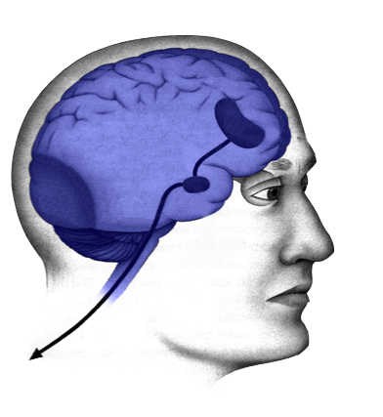
TWO SYSTEMS
Limbic
System
Cognitive
System
+
Feeling
Mind
Thinking
Mind

Slide 24
Decreases decision making ability
Lose our higher reasoning
Impairs short term memory
Narrows our focus – become mentally rigid

Slide 25
Notes:
Time: 2 minutes
Objective: Illustrate the idea that emotions are primary drivers of our physiology.
Key Points:
A man was wearing a 24-hour Holter monitor, which is used to measure heart rhythms.
He and his wife were arguing in their car. The man was sitting on the passenger side wearing his seatbelt. When they began arguing, his heart rate shot up to over 140 BPM and remained elevated at that rate for about 15 minutes.
After they made up, his heart rate remained elevated for another hour. (Point to second red arrow.)
Ask: How much energy did he burn up from being angry or frustrated?
The result was a rapid drain of his inner battery. This is a good way of illustrating that emotions are primary drivers of physiology.
Ask: How much emotional energy is unnecessarily spent in the workplace because of drama, relationship and communication issues?
Transition: Our emotions directly affect our resilience.

Slide 26
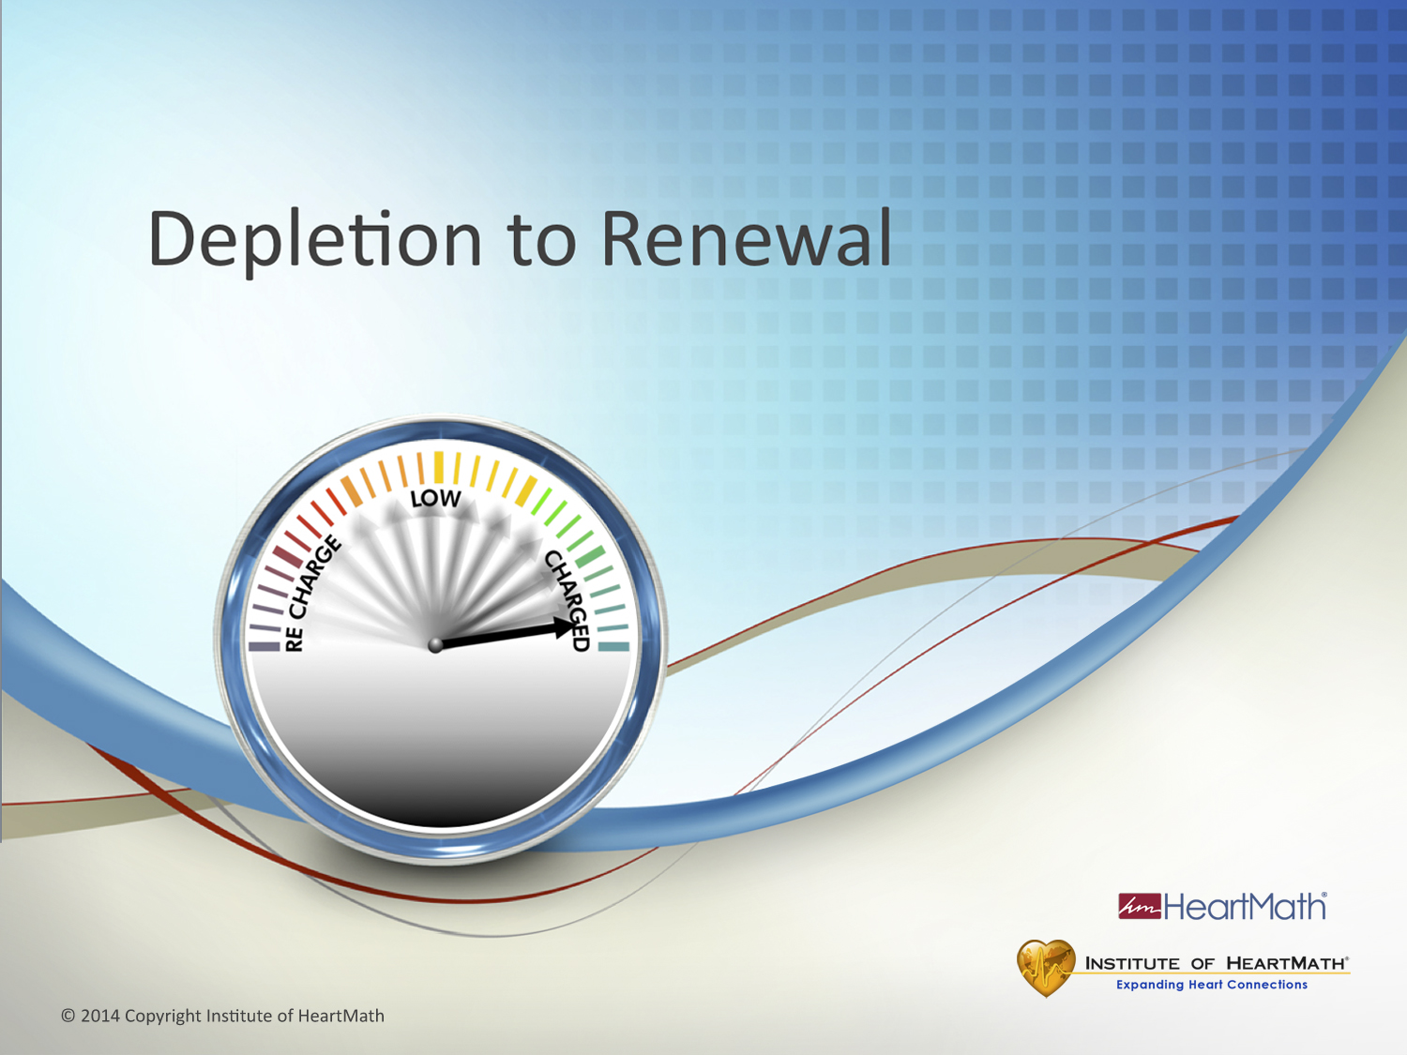
Notes:
Time: 30 seconds Objective: Introduce the Depletion to Renewal Grid.
Key Points: The Depletion to Renewal Grid is a research-based tool that provides a visual illustration of the relationship between typical emotional responses, their intensity and how those responses affect energy, performance, communication, resilience and the ability to self-regulate.
Transition: Emotions are not “good or bad” but they are primary drivers of physiology. This next exercise illustrates how different emotions – depleting or renewing – affect two primary systems. (Click to Grid).
Depletion to Renewal – Exercise
Time: Exercise total: 20 minutes Objectives: Identify two systems affected by emotions: the autonomic nervous system and hormonal system. Identify emotions and where they land on the Depletion to Renewal Grid. Engage the audience in self-awareness around what emotions they experience. Develop understand ing that depleting or renewing emotions have different effects on our physiology. Key Points:
(Show the slide and then blacken the screen. (Note: if you don't have a flip chart or white board, talk through the Grid using the slide.)
Take the audience through the Depletion to Renewal Grid using a Flip Chart or White board. Draw a vertical line as you explain the ANS: The vertical line represents the Autonomic Nervous System (ANS).
The ANS has two branches, one that speeds things up (increases heart rate) – sympathetic branch – and one that slows things down (decreases heart rate) – parasympathetic branch. (Write sympathetic – high heart rate at the top of the vertical line. Write parasympathetic – low heart rate at the bottom. Under parasympathetic, write relaxation). The ANS governs 90% of our body’s internal functions.
Draw a horizontal line in the middle of the vertical line as you explain: The horizontal line represents a key part of the hormonal system that regulates many other hormones and systems. Hormones are important because once secreted, some of them will remain active and circulating in the body for hours and have a long lasting effect. There are two key hormones that are impacted by the emotions we experience: Cortisol and DHEA.
(Write cortisol on the left side and explain), Cortisol is commonly known as the “stress hormone”. (Write DHEA on the right side and explain), DHEA is commonly known as the “vitality hormone”. (People need to know that cortisol is a hormone we need, but when we secrete too much or too little, there can be health implications—see references in the back of the guidebook.)
We all experience a wide range of emotions throughout a typical day. We may land all over the grid; we’re human so this is normal.
Our focus today is to identify those emotions, where they land on the grid and to learn techniques to help us cultivate more renewing emotions to enhance our resilience and charge our inner battery. (Trainer solicits one or two examples for each quadrant. Start in the upper LEFT quadrant of the Grid and work your way around to the upper right.)

Slide 27
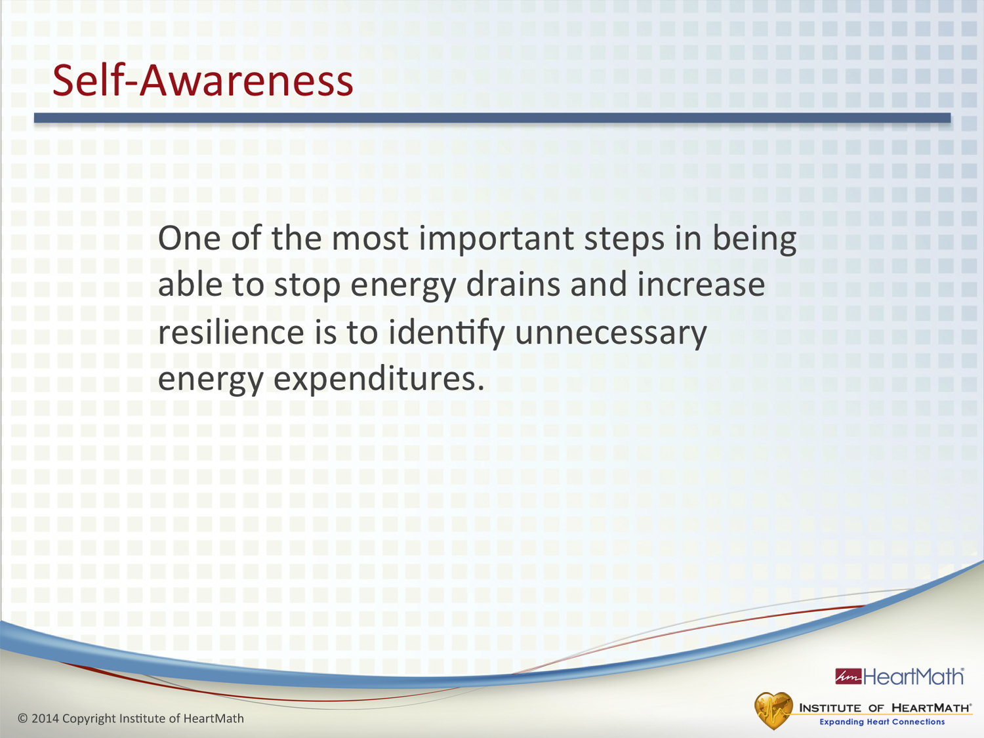
Notes:
Time: 6-8 minutes
Objective: Inform participants that the first step in increasing resilience is identifying unnecessary energy expenditures.
Key Points:
•Identifying where you are draining your energy is the first step in building resilience.
•You can’t plug leaks if you don’t know where you are draining your energy.
•Let’s turn to the Energy-Depleting Situations Exercise in the Guidebook.
•Identify situations, events, interactions or attitudes that drain your inner battery and write them down.
•Identify or name the feeling or emotion you experienced for each: for example, impatience, resentment, anxiety or anger.
•Identify your current solution for handling those situations.
•(Give participants a couple of minutes to complete exercise, then debrief them.)
•Ask: What are some examples of unnecessary energy expenditures?
Transition: Let’s start with a couple of techniques designed to help you plug energy leaks and recharge your inner battery.
Exercise

Slide 28
Stand UP
What were your symptoms?
What is a time at work or home that you may feel the same symptoms?

Slide 29
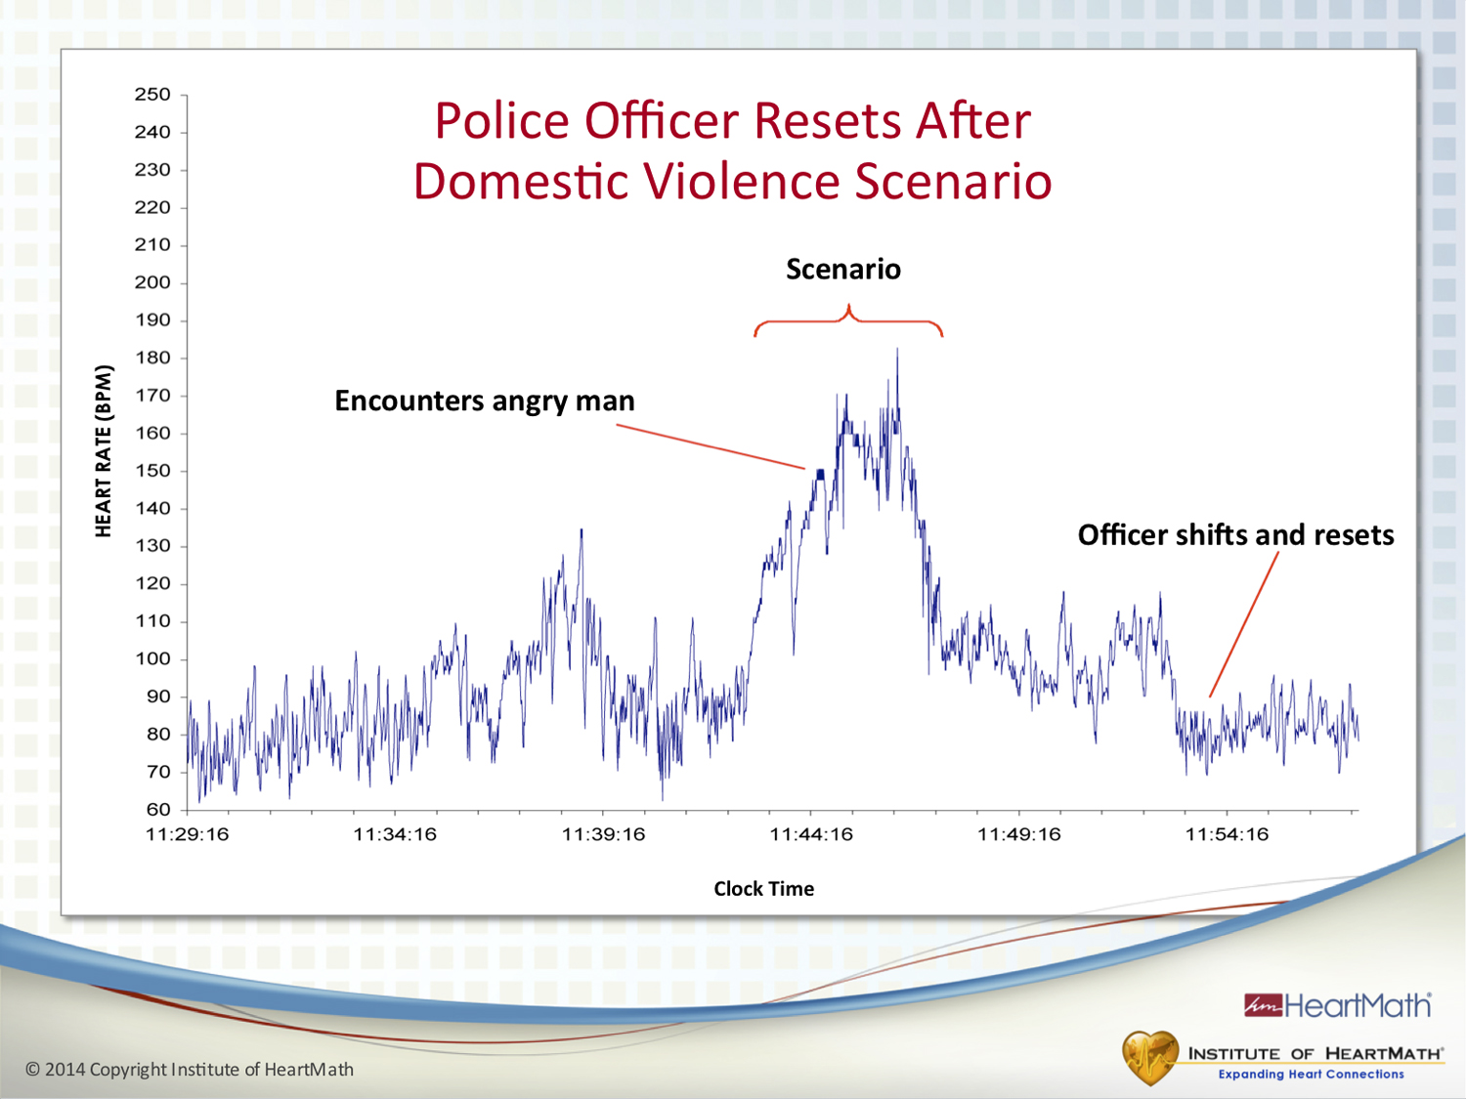
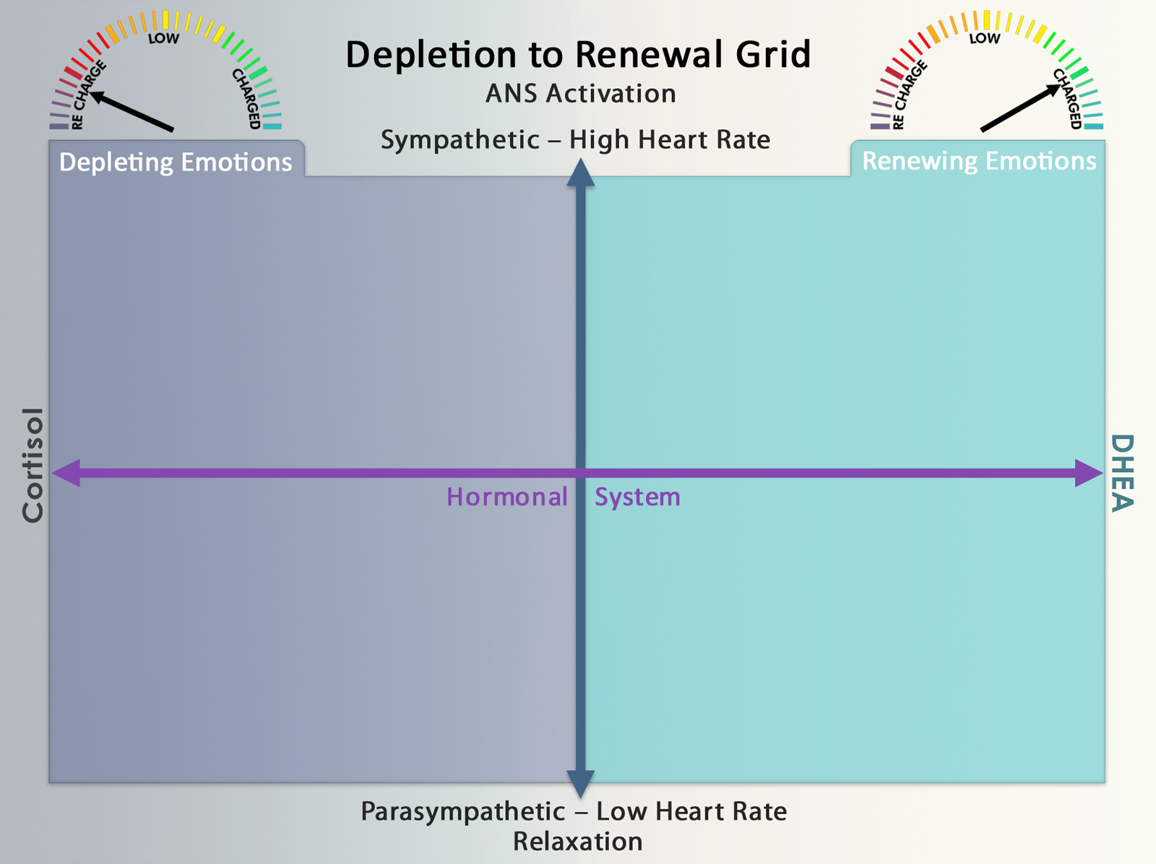

Notes:
Exercise:
Now ask the participants to go to their guidebook and take 2-3 minutes to fill in the four quadrants.
Ask: Ask yourself what emotions you have experienced over the last week or so that depleted you (drained your inner battery) and what emotions renewed you (charged your inner battery). Any questions?
If needed, share more examples that could help participants fill in their Grid:
Frustrated in a meeting
Angry over a communication
Sad because a friend is ill
Depressed because you don’t have enough family time
Peaceful or calm at the end of a good day
Excited after hearing good news
Exhilarated after a great ski run
(Give the audience 3-4 minutes to fill out their grid).
Ask the participants to bring their attention back to the front of the room.
(Debrief by gathering examples from the participants, starting in the upper left and working your way around to the upper right. Get as many examples as you can to fill in the Flip Chart.
(NOTE: If someone says exhausted, tired, etc., in any of the left hand quadrants, coach them to find out the accompanying emotion. Write only the emotion in the quadrants.)
(If someone says ‘relaxed’ for the lower right quadrant, coach them to find out the renewing emotion they experienced when they were relaxed. This is a time you could remind them of the difference between coherence and relaxation. Write only the emotion in the lower right quadrant.)
(Point to the entire left side of the grid):
Say: The entire left side of this grid represents the depleting emotions – draining our inner battery.
(Point to the entire right side of the grid):
Say: The entire right side represents the renewing side of the grid – charging our inner battery.
(When you finish filling out the Grid:)
Ask four questions:
What emotions do you experience regularly that are renewing?
What emotions do you experience regularly that are depleting?
In which quadrant do you spend most of your time?
Where would you like to spend more time?
The goal is to spend more time on the right side of this grid than the left. Life happens so we won’t always be able to do that, but the more time we spend on the right side, we increase our inner battery and build resilience.
Transition: We have already learned two intelligent energy self-regulation techniques that can help bring synchronization to the Autonomic Nervous System: Heart-Focused Breathing and Inner-Ease; now let’s add another self-regulation technique to add even more coherence to our physiology to balance the two key hormones that are affected by our emotions.
(Now, point to the upper LEFT quadrant of the Grid):
Ask: What is one example of a depleting emotion that speeds up heart rate?
Now let’s move down to the lower LEFT quadrant.
Ask: What would be one depleting emotion where we experience a low heart rate?
(Point to the lower RIGHT quadrant):
Ask: What is one example of a renewing emotion that is accompanied by a low heart rate?
(Point to the upper RIGHT quadrant):
Ask: How about one example of a renewing emotion that is accompanied by a high heart rate?

Slide 30
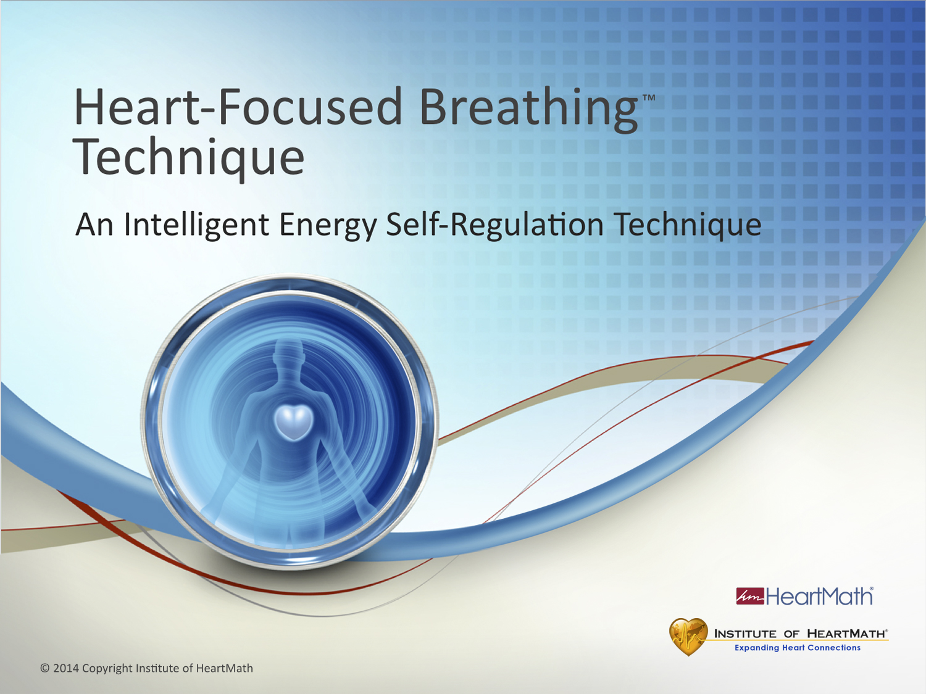
Notes:
Time: 30 seconds
Objective: Introduce the Heart-Focused Breathing module.
Key Point:
Heart-Focused Breathing is an easy-to-use, energy-saving self-regulation strategy designed to reduce the intensity of a stress reaction and to establish a calm, but alert state.
Transition: Ask: How many of you have learned some type of breathing technique?

Slide 31
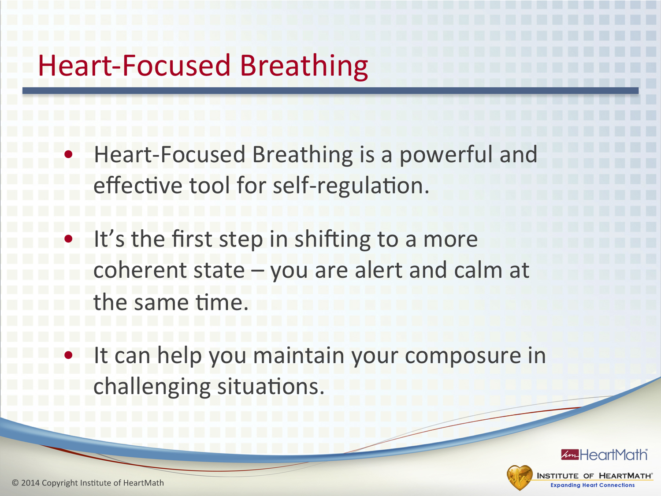
Notes:
Time: 1-2 minutes
Objective: Introduce the Heart-Focused Breathing Technique.
Key Points:
Ask: What are some breathing techniques you have learned?
Ask: How many of you have kids? If they hurt themselves or are upset, what do you do? Often times we suggest they take a couple deep breaths to calm down, which can help them change their focus. It is interesting that adults forget to do this for themselves.
Breathing techniques have been around a long time and are widely used because they are effective.
We can gain benefit from conscious breathing if we use it to help us shift into and sustain a more balanced state, understanding that breathing is only the start of what we call the coherence-building process.
Heart-Focused Breathing is the first step in regulating our energy. We will build on this step in the techniques that follow.
Transition: This is a deceptively simple technique. Once you gain experience in using it, you may find, as many people do, it can be a powerhouse tool. Let’s go over the Heart-Focused Breathing Technique.

Slide 32
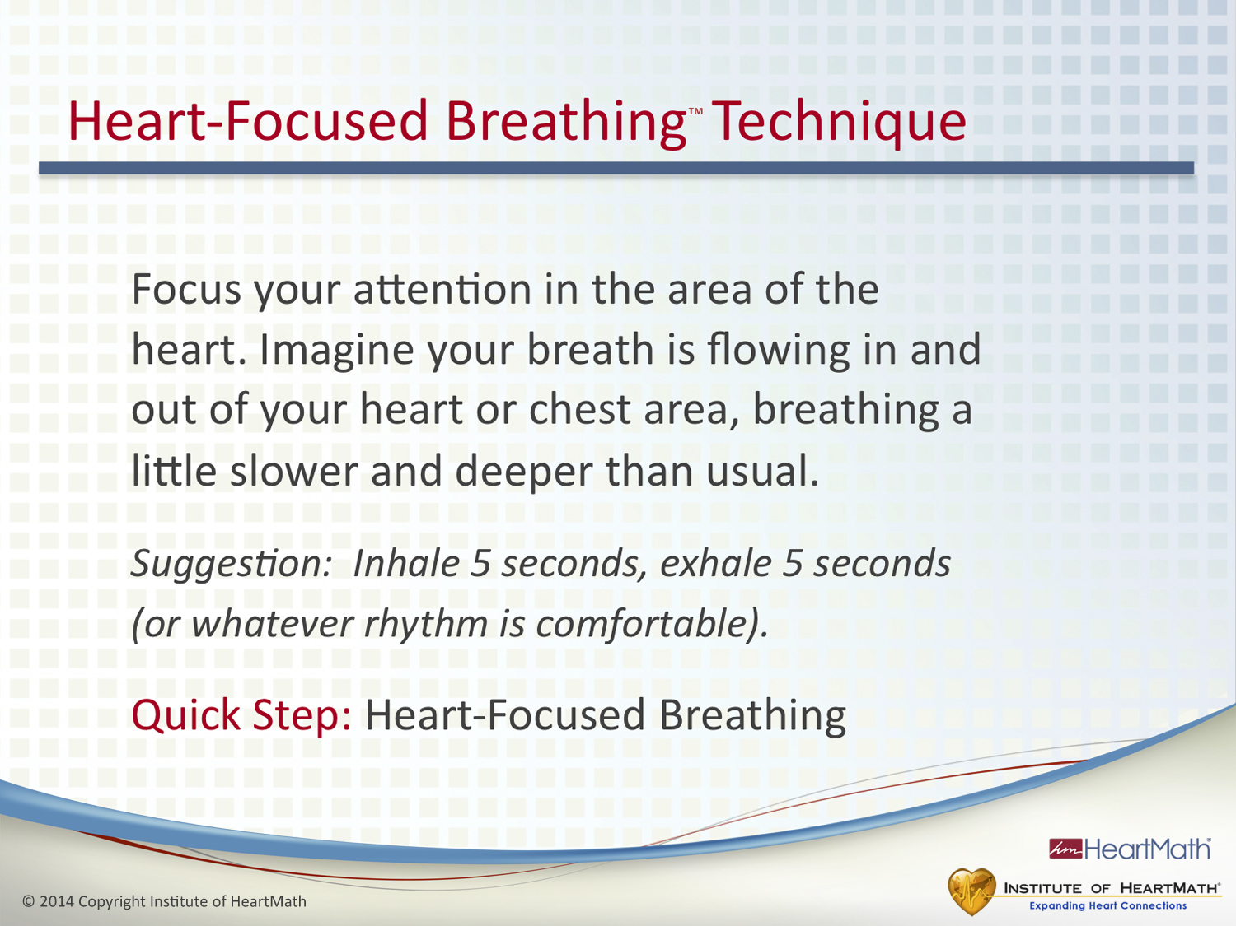
Notes:
Time: 5 minutes
Objective: Learn and practice the Heart-Focused Breathing Technique.
Key Points:
Let’s practice the Heart-Focused Breathing Technique together as I read it to you.
Read the step: Focus your attention in the area of the heart. Imagine your breath is flowing in and out of your heart or chest area, breathing a little slower and deeper than usual.
Suggestion: Inhale 5 seconds, exhale 5 seconds (or whatever rhythm is comfortable.)
Try practicing Heart-Focused Breathing with your eyes open. Soon you will be able to do it on the go and no one will know you are doing it.
Ask: Why do we focus our attention on the area of the heart? It has been demonstrated that when we focus our attention on a specific area of our body, it leads to measurable physiological changes in that area. In this case, shifting attention to the heart area helps shift our heart rhythms into a more coherent state. It also draws our focus of attention away from an issue, which further helps calm our thoughts and stabilize our emotions.
(Helpful tip: If participants have difficulty focusing on the heart area, have them shift their focus to their left index finger and wiggle it. Then have them shift their focus to their right big toe and wiggle it. Explain that this is what we mean by focusing attention. Now have them focus in the area of the heart.)
Heart-Focused Breathing creates an inner pause. In that pause you can become aware that you have a choice of how you want to respond. In other words, you don’t have to respond in an automatic, knee-jerk kind of reaction or behavior. That new choice can change the trajectory of the moment and the outcome.
Use Heart-Focused Breathing in the moment to help take the intensity out of or turn down the volume of a stress reaction. You can use it, for example, to increase your composure before a meeting or conversation.
The Quick Step is simply Heart-Focused Breathing. Once you are comfortable doing the technique, that’s all you will need to remember. Transition: Let’s identify situations, events, interactions or attitudes that you know renew your energy.
OPTIONAL Self-Awareness EXERCISE – Renewing Time: 5-7 minutes Objective: Inform participants that they can recharge their inner batteries to build resilience.
Key Points:
Let’s turn to the Energy-Renewing Situations Exercise in the guidebook.
Identify situations, events, interactions or attitudes that give you the feeling of renewal and recharging your inner battery.
Next identify or name the feeling or emotion you experienced for each, for example, contentment, joy, appreciation, care or excitement.
(Give participants a couple of minutes to complete exercise, then debrief them).
Ask: Did you notice that emotions can affect you quite differently: Some are depleting and some are renewing?
Transition: In challenging situations Heart-Focused Breathing often is the first step that will help us calm down. Another self-regulation technique that adds ease to your daily routine is the Inner-Ease Technique. Let’s review it now:

Slide 33
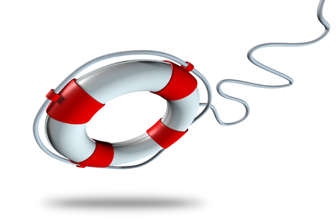

S
top
O
xygenate
S TRENGTHEN attitude/one word feeling
© 1998-2013 IHHP Inc.
Notes:
Let’s explore a 3-step self-regulatory strategy called SOS that will help you effectively soothe the Amygdala when you feel it beginning to fire.
This strategy is called your emotional life preserver. The 3 steps are Stop, Oxygenate and Seek Information.
Let’s take a closer look at each step.
On the day you get stuck in traffic on your way back to the office and are rushing, harried and anxious about being on time, you need to clear your feelings before speaking with your client so that you can concentrate fully on the client and not on your troubles.
***Knocking off balance which is why you need SA and EM to realize when it is happening and EM to keep you okay

Slide 34
Managing the “O’s”
Ourselves
Others
Our Communication

Slide 35

Building Bridges From Our Side
      We tend to build the bridge from our side based on what we think we have heard, or the conclusions we have jumped to.
Your Perspectives…
Beliefs
Opinions
Assumptions
Experiences
Needs/Concerns
2
3
1
Understanding Gap
3
3

Slide 36
Building Bridges From Their Side
      If we build the bridge from their side first, we suspend judgement and start looking to understand what they really mean; to understand them first.
…Their Perspective
Beliefs -
Opinions -
Assumptions -
Experiences -
Needs/Concerns -
3
2
1
Understanding Gap
3
3

Slide 37
Managing the “O’s”
Ourselves
Others
Our Communication

Slide 38
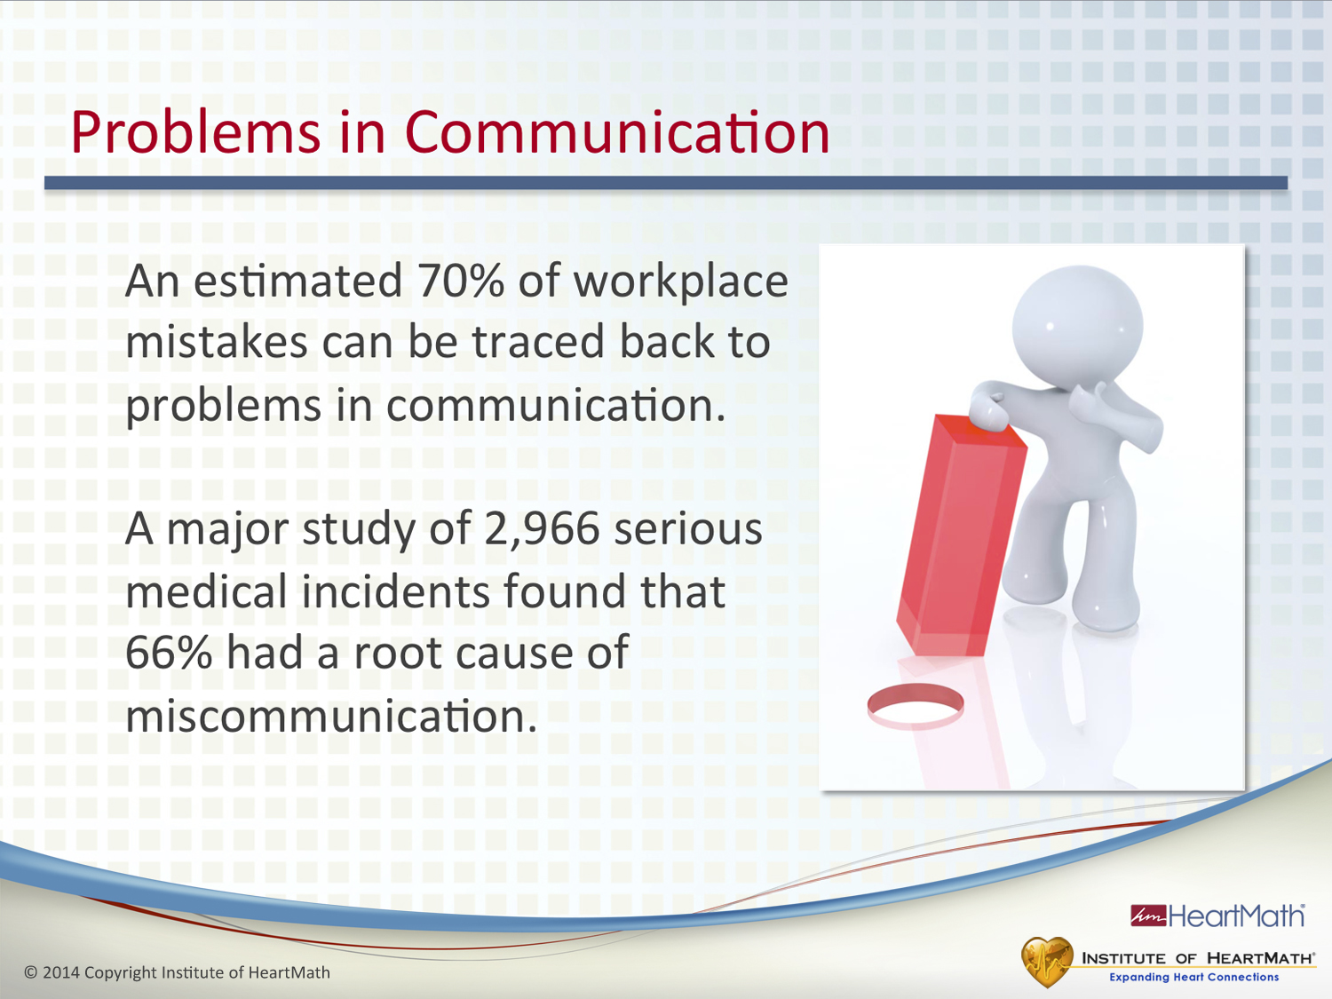
Notes:
Time: 1 minute
Objective: Inform participants of two studies that found the root cause of errors was miscommunication.
Key Points:
Research has shown that 70% of workplace mistakes can be traced to problems in communication.
Another study looked at nearly 3,000 serious medical incidents and found that 66% had miscommunication as their root cause.
Ask: How much time, energy and money are wasted because of mistakes caused by miscommunication?
Transition: Let’s talk about a large source of communication problems: drama.

Slide 39
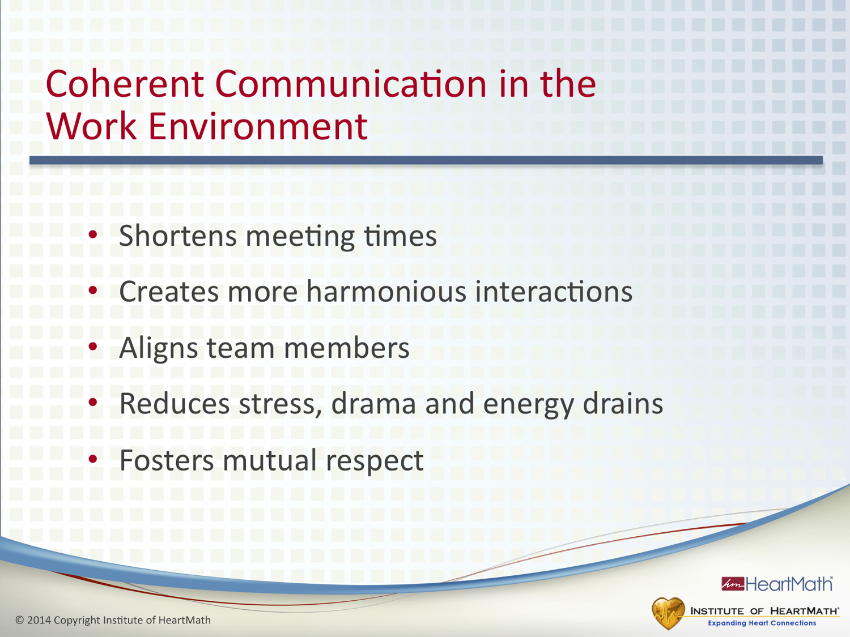
Notes:
Time: 1 minute
Objective: Discuss benefits that are commonly reported after practicing the techniques to increase coherence in the work environment.
Key Point:
•Practicing coherent communication can shorten meeting times, create more harmonious interactions, align team members, reduce stress, drama and energy drains and foster mutual respect among co-workers and team members.
Transition: Using the next technique consistently can help us establish a new baseline of resilience.

Slide 40
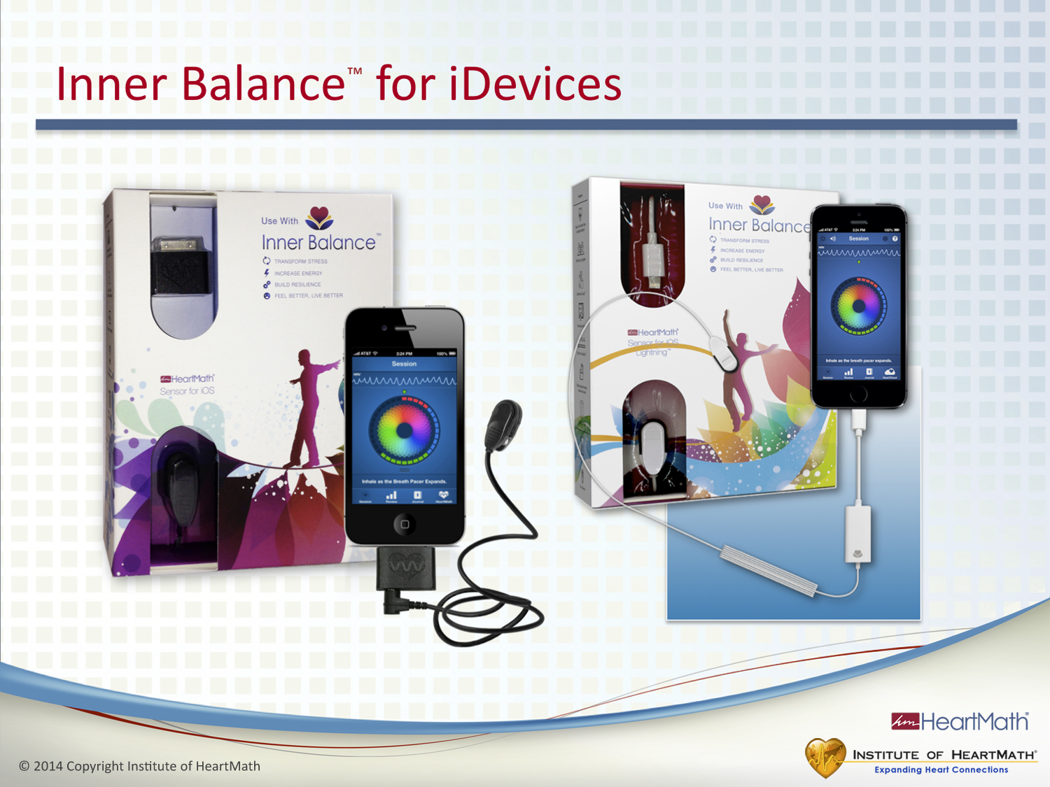
Notes:
Time: 1 minute
Objective: Inform participants about the Inner Balance app for iPhones and iPads.
Key Points:
The Inner Balance sensor attaches to your iDevice and measures your coherence level. It gives you an overall achievement score, shows your heart-rhythm patterns and provides progress reports. There also is a journal feature in the software.
(Add the technology slides that illustrate the screens and functions here if you are demonstrating this technology.)
Transition: Let’s learn three basic strategies for building and sustaining our resilience.

Slide 41
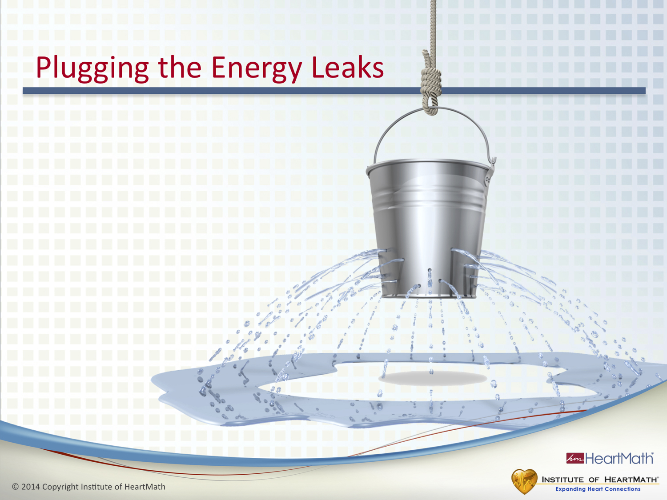
Notes:
Time: 6 minutes
Objective: Identify a practice to plug energy leaks.
Introduction to Exercise:
Identify one situation you will commit to “taking on” that drains your energy and which technique(s) and strategies you will use for the next two weeks to plug the energy leaks.
You can think of it as committing to not reacting in the energy-draining way that you typically do. That’s what we mean by “taking on” a challenge.
Ask:
What technique(s) will you use?
When will you use them?
How will you remind yourself?
Ask: What will most likely get in the way of this practice for the next two weeks? What can you do so that they will not get in your way?
(Optional: After participants have completed the worksheets, have them share a couple of appropriate examples.)
Transition: Now let’s identify and commit to specific actions you will take to build resilience over the next two weeks.

Slide 42
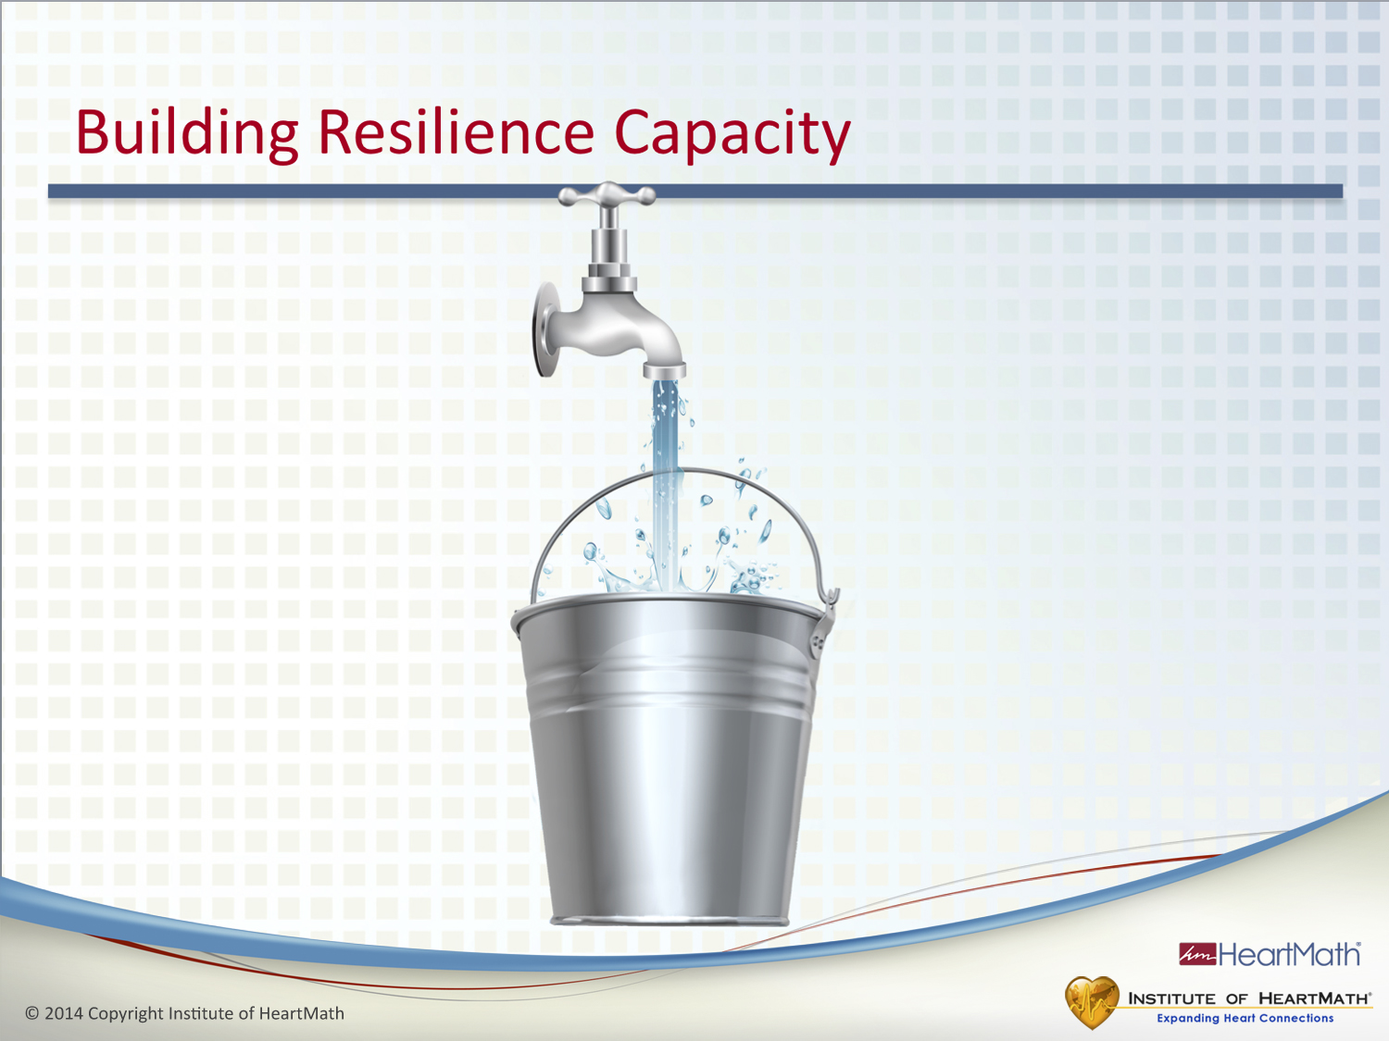
Notes:
Time: 6 minutes
Objective: Have participants identify and encourage them to commit to a specific practice for building resilience.
Identify a practice for building your resilience that you will commit to over the next two weeks.
You can think of it as something you are deciding that you will commit to do to build your resilience.
Ask:
What technique(s) will you use?
When will you use them?
How will you remind yourself?
Ask: What will most likely get in the way of this practice for the next two weeks? What can you do?
(Optional: After participants have completed the worksheets, have them share a couple of appropriate examples.)
Transition: (Click to the next slide).

Slide 43

Thank You

